Slide 1
DevOps

Slide 2
Topics
What is DevOps?
Support for Development Processes
What DevOps is NOT
DevOps Process
Benefits
Popular DevOps Tools

Slide 3
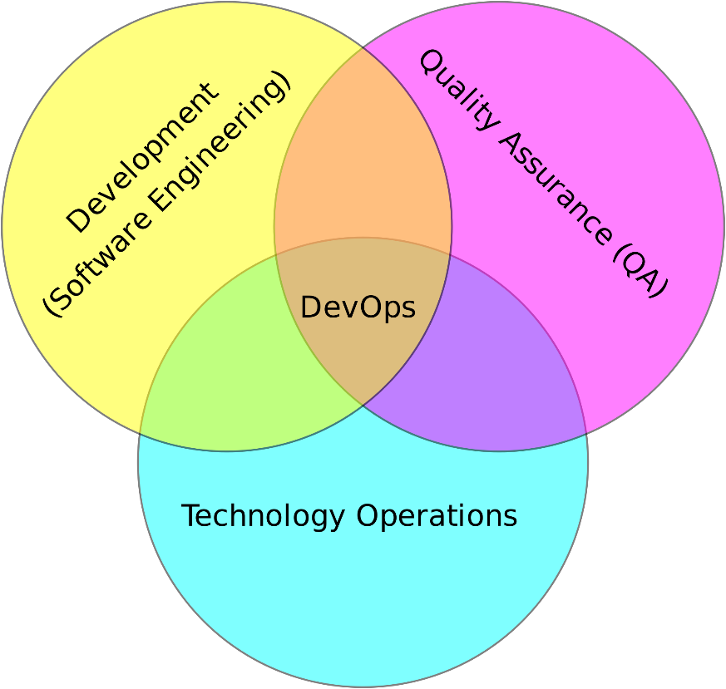
What is DevOps?
Automated Testing
Continuous Integration
Continuous Delivery
Automated Infrastructure
Automated… everything
Notes:
Automated tests, code coverage 80-90+%, developers must know value of testing their code

Slide 4
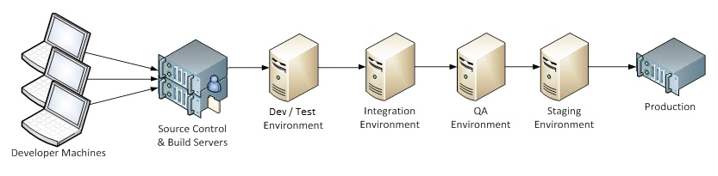
Support for Development Processes

Slide 5
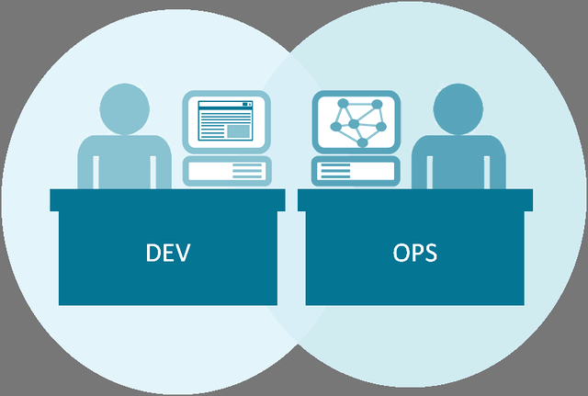
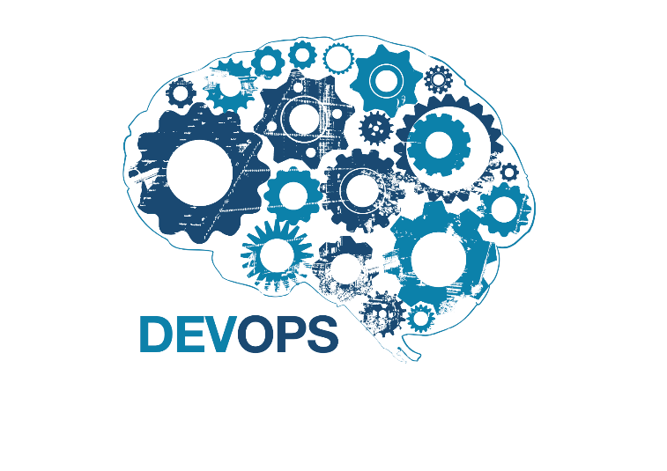

What DevOps is NOT
Not simply developers with operations skills (or vice versa)
Not a product, software, or hardware technology—it is a culture
Not an unattainable goal
Used by Netflix, Walmart, Facebook, General Electric, and more
DevOps is a mindset! A culture change!

Slide 6
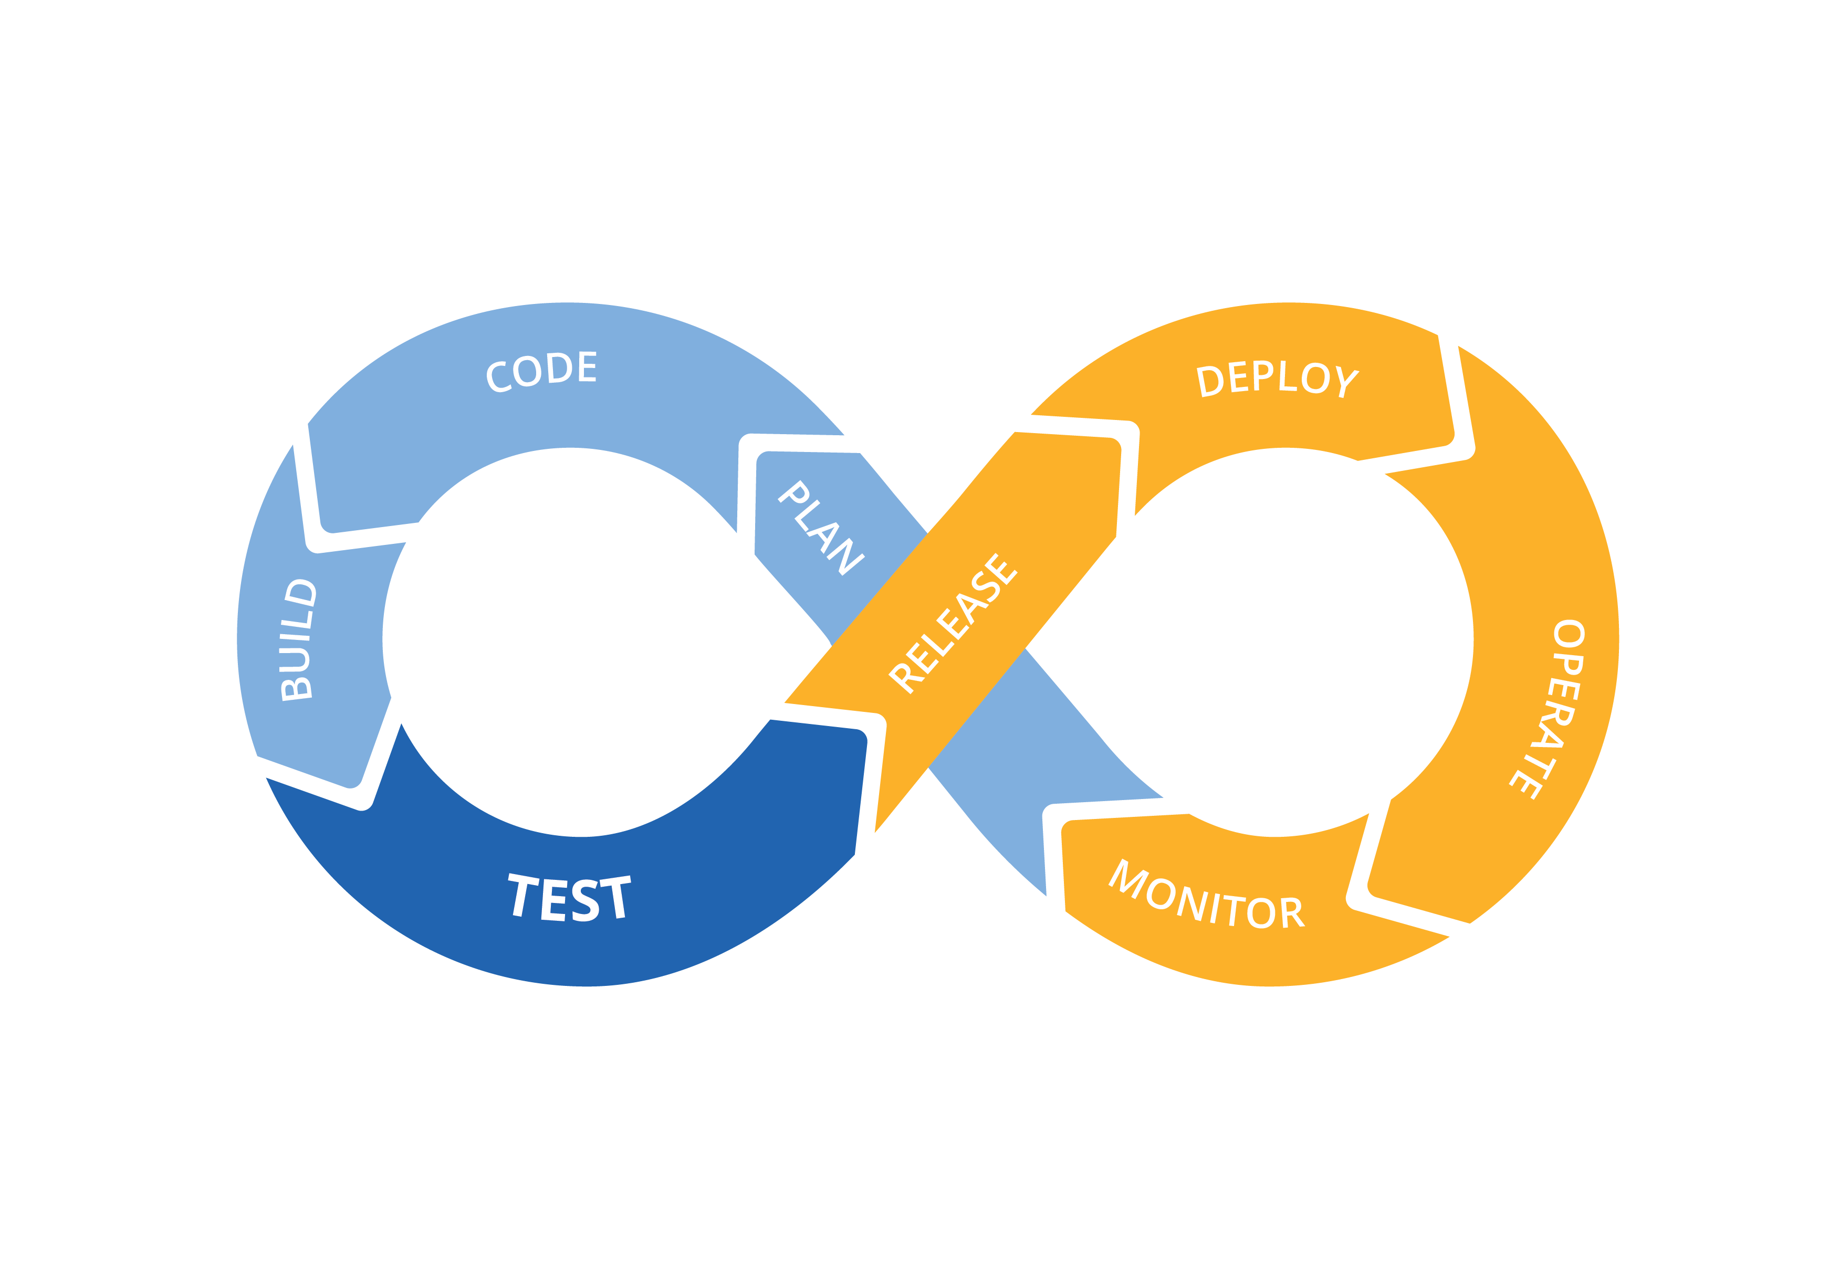







DevOps Process
Notes:
Maven can execute unit tests during a build. Jenkins can kick off automated tests and Maven builds too. Maven can also be used to automated deployment and releases!
Nexus can act as a release manager—maintaining older versions of builds and supply environments with a convenient download for releases.
JIRA helps with monitoring by providing a defect ticketing system to track quality and performance issues.

Slide 7
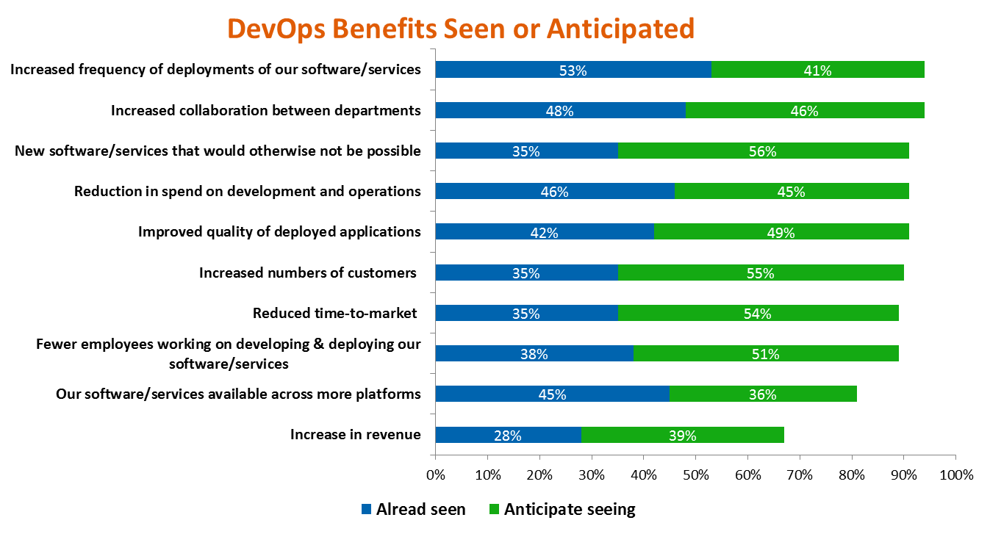
Benefits

Slide 8

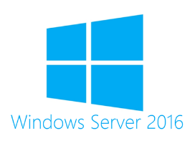






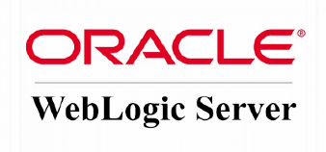
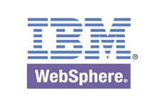

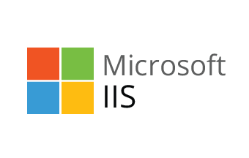


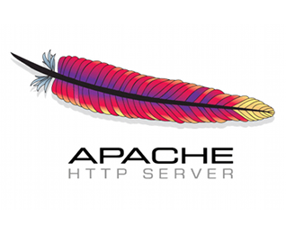
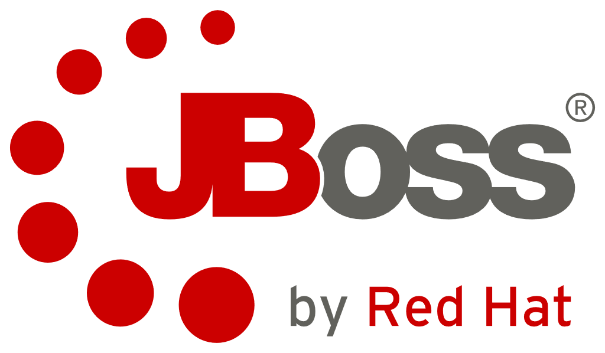

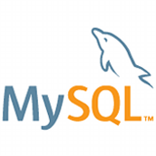
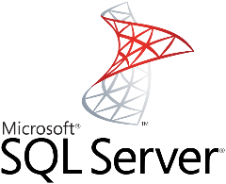
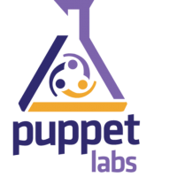
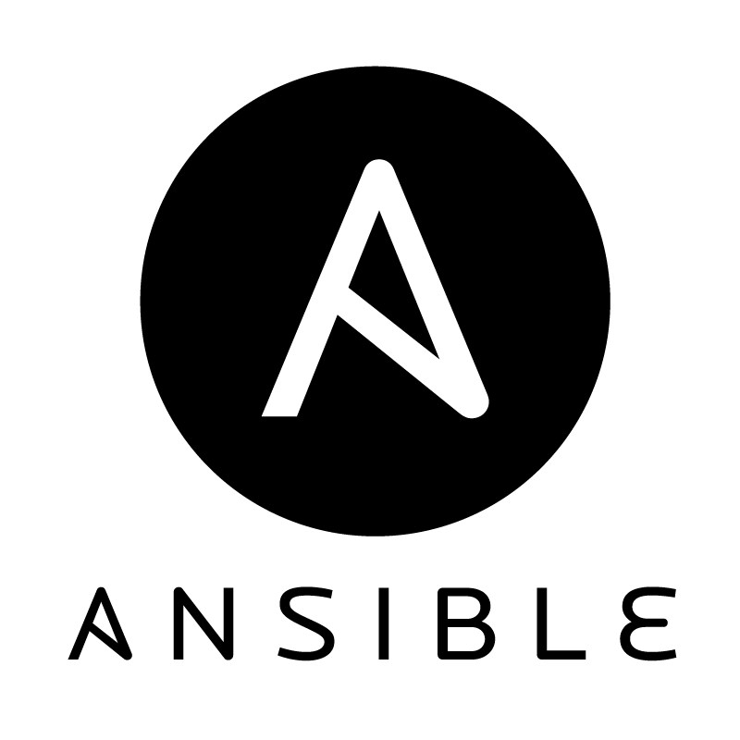

Popular DevOps Tools
Operating Systems Test and Build Systems
IaaS Application Servers Web Servers
Configuration Management Databases
See more at http://newrelic.com/devops/toolset
Notes:
http://newrelic.com/devops/toolset

